Slide 1
Lecture 10 : CSE2004 – DBMS
Functional dependencies

Slide 2
Outline
Informal Guidelines
Functional Dependencies
Normal Forms Based on Primary Keys
First Normal Form
Second Normal Form
Third Normal Form
BCNF (Boyce-Codd Normal Form)
Fourth Normal Form
Fifth Normal Form

Slide 3
Objectives of database normalization
To correct duplicate data and database anomalies.
To avoid creating and updating any unwanted data connections and dependencies.
To prevent unwanted deletions of data.
To optimize storage space.
To reduce the delay and complexity of checking databases when new types of data need to be introduced.
To facilitate the access and interpretation of data to users and applications that make use of the databases.

Slide 4
Normalization of Relations
Normalization: The process of decomposing unsatisfactory "bad" relations by breaking up their attributes into smaller relations
Normal form: Condition using keys and FDs of a relation to certify whether a relation schema is in a particular normal form

Slide 5
Normalization of Relations
A superkey of a relation schema R = {A₁, A₂, ...., A_{n}} is a set of attributes S subset-of R with the property that no two tuples t₁ and t₂ in any legal relation state r of R will have t₁[S] = t₂[S]
A key K is a superkey with the additional property that removal of any attribute from K will cause K not to be a superkey any more.
If a relation schema has more than one key, each is called a candidate key. One of the candidate keys is arbitrarily designated to be the primary key, and the others are called secondary keys.
A Prime attribute must be a member of some candidate key
A Nonprime attribute is not a prime attribute—that is, it is not a member of any candidate key

Slide 6
1 Informal Design Guidelines for Relational Databases
1.1Semantics of the Relation Attributes
1.2 Redundant Information in Tuples and Update Anomalies
1.3 Null Values in Tuples
1.4 Spurious Tuples
2 Functional Dependencies (FDs)
2.1 Definition of FD
2.2 Inference Rules for FDs
2.3 Minimal Sets of FDs

Slide 7
1.1 Semantics of the Relation Attributes
GUIDELINE 1: Informally, each tuple in a relation should represent one entity or relationship instance. (Applies to individual relations and their attributes).
Attributes of different entities (EMPLOYEEs, DEPARTMENTs, PROJECTs) should not be mixed in the same relation
Only foreign keys should be used to refer to other entities
Entity and relationship attributes should be kept apart as much as possible.
Bottom Line: Design a schema that can be explained easily relation by relation. The semantics of attributes should be easy to interpret.

Slide 8
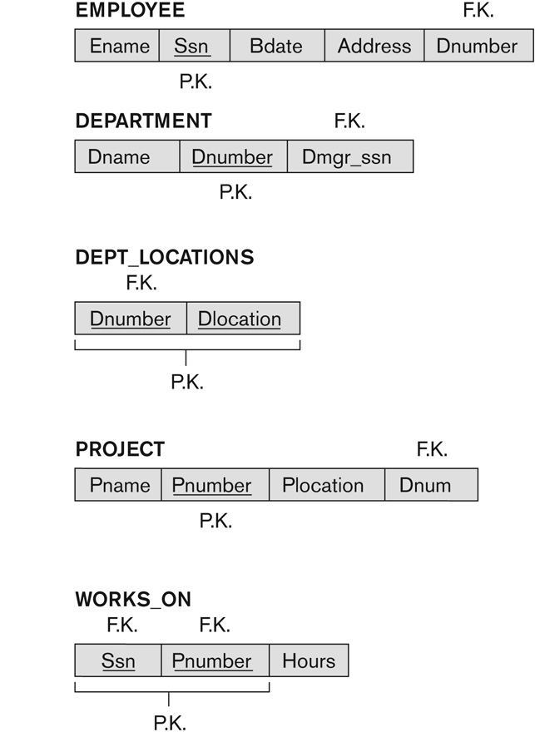
A simplified COMPANY relational database schema

Slide 9
1.2 Redundant Information in Tuples and Update Anomalies
Information is stored redundantly
Wastes storage
Causes problems with update anomalies
Insertion anomalies
Deletion anomalies
Modification anomalies

Slide 10
EXAMPLE OF AN UPDATE ANOMALY
Consider the relation:
EMP_PROJ(Emp#, Proj#, Ename, Pname, No_hours)
Update Anomaly:
Changing the name of project number P1 from “Billing” to “Customer-Accounting” may cause this update to be made for all 100 employees working on project P1.

Slide 11
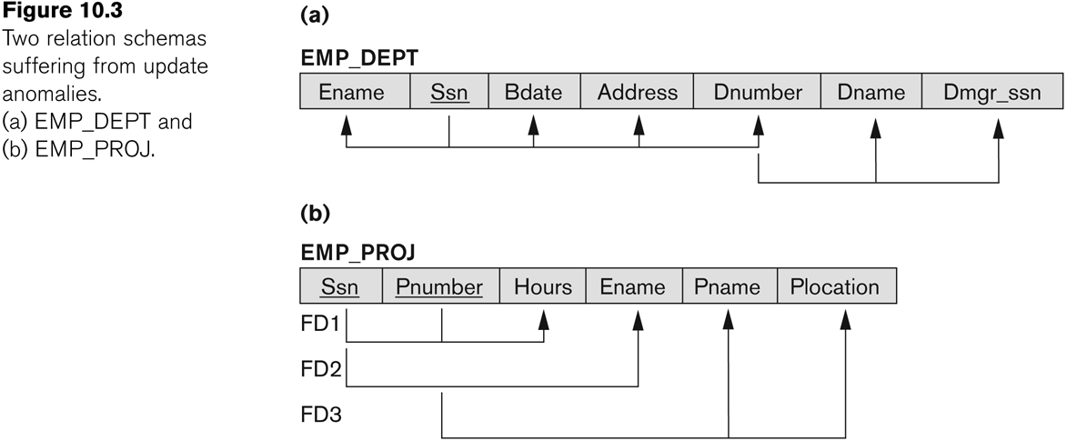
Two relation schemas suffering from update anomalies

Slide 12
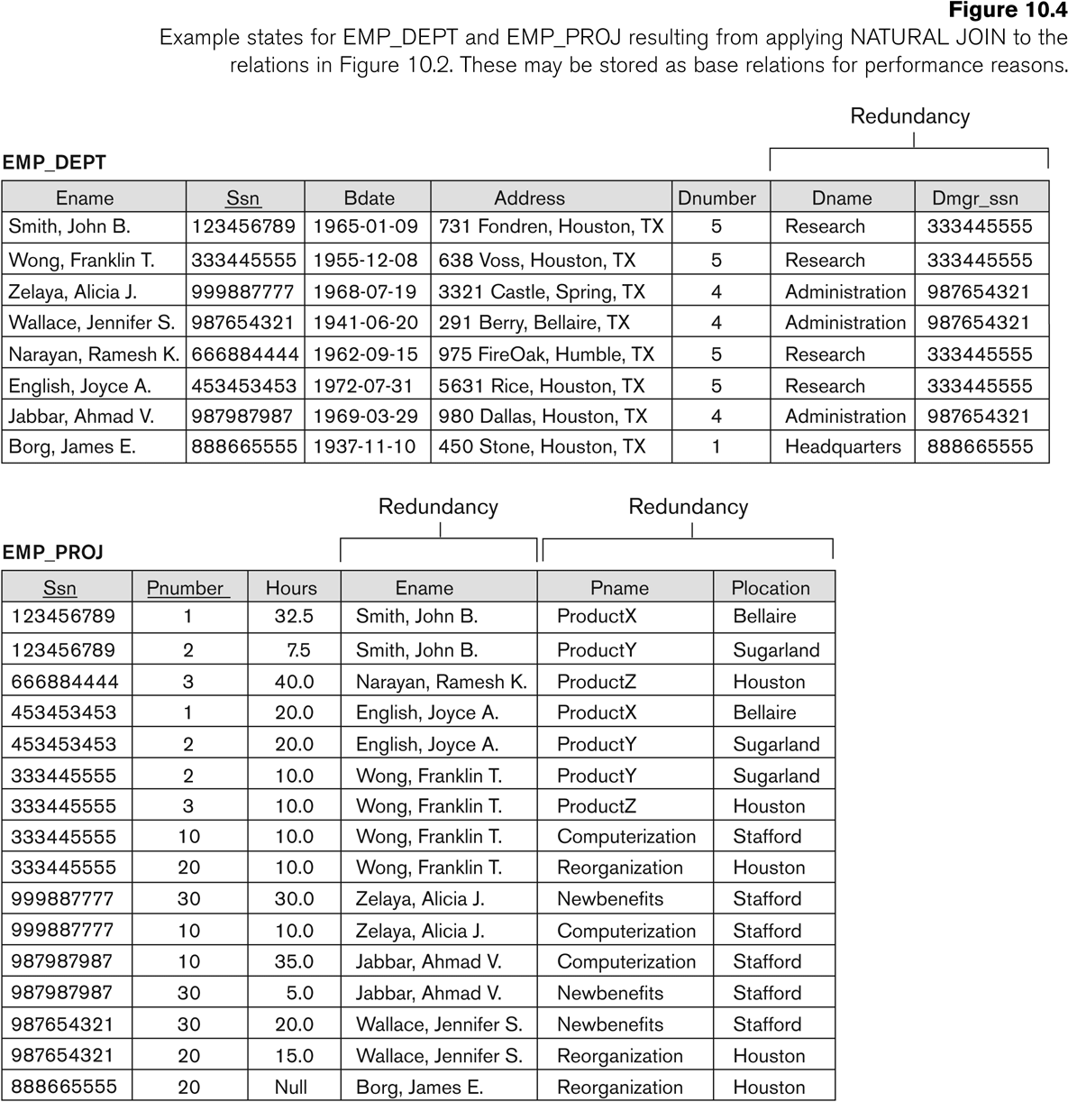
Example States for EMP_DEPT and EMP_PROJ

Slide 13
EXAMPLE OF AN INSERT ANOMALY
Consider the relation:
EMP_PROJ(Emp#, Proj#, Ename, Pname, No_hours)
Insert Anomaly:
Cannot insert a project unless an employee is assigned to it.
Conversely
Cannot insert an employee unless an he/she is assigned to a project.

Slide 14
EXAMPLE OF AN DELETE ANOMALY
Consider the relation:
EMP_PROJ(Emp#, Proj#, Ename, Pname, No_hours)
Delete Anomaly:
When a project is deleted, it will result in deleting all the employees who work on that project.
Alternately, if an employee is the sole employee on a project, deleting that employee would result in deleting the corresponding project.

Slide 15
Guideline to Redundant Information in Tuples and Update Anomalies
GUIDELINE 2:
Design a schema that does not suffer from the insertion, deletion and update anomalies.
If there are any anomalies present, then note them so that applications can be made to take them into account.

Slide 16
1.3 Null Values in Tuples
GUIDELINE 3:
Relations should be designed such that their tuples will have as few NULL values as possible
Attributes that are NULL frequently could be placed in separate relations (with the primary key)
Reasons for nulls:
Attribute not applicable or invalid
Attribute value unknown (may exist)
Value known to exist, but unavailable

Slide 17
1.4 Spurious Tuples
Bad designs for a relational database may result in erroneous results for certain JOIN operations
The "lossless join" property is used to guarantee meaningful results for join operations
GUIDELINE 4:
The relations should be designed to satisfy the lossless join condition.
No spurious tuples should be generated by doing a natural-join of any relations.

Slide 18
Spurious Tuples
There are two important properties of decompositions:
Non-additive or losslessness of the corresponding join
Preservation of the functional dependencies.
Note that:
Property (a) is extremely important and cannot be sacrificed.
Property (b) is less stringent and may be sacrificed.

Slide 19
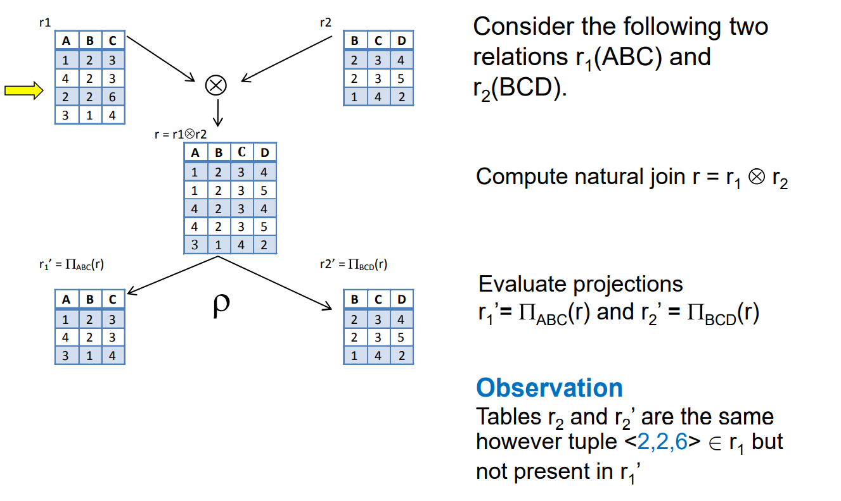

Slide 20
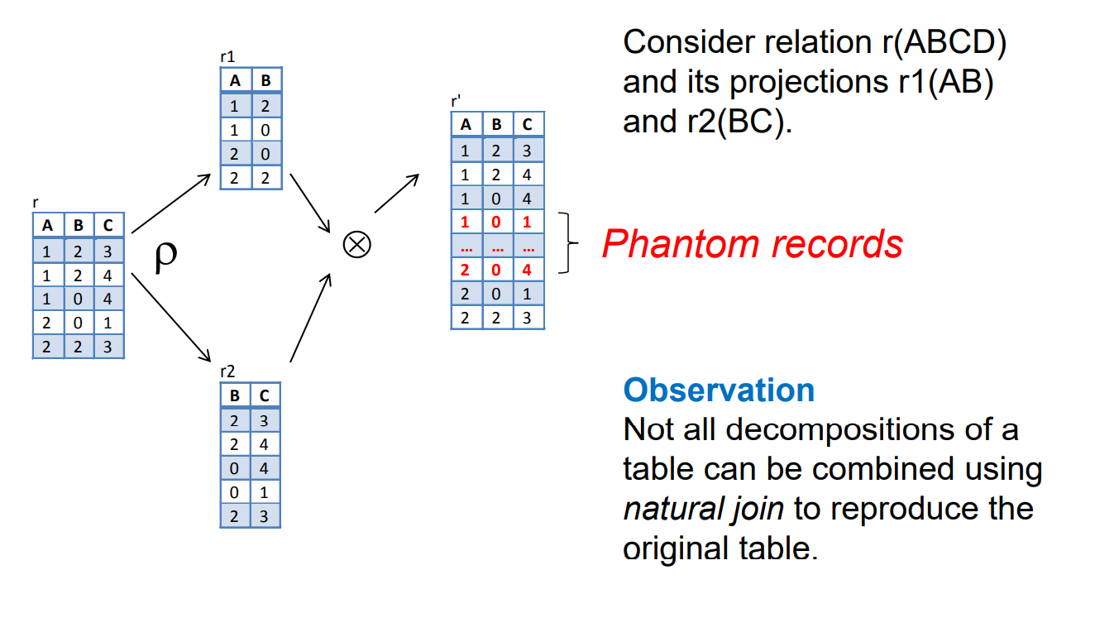

Slide 21
Functional Dependencies

Slide 22
2. Functional Dependencies
Functional dependencies (FDs)
Are used to specify formal measures of the "goodness" of relational designs
And keys are used to define normal forms for relations
Are constraints that are derived from the meaning and interrelationships of the data attributes
A set of attributes X functionally determines a set of attributes Y if the value of X determines a unique value for Y

Slide 23
Functional Dependencies
X -> Y holds if whenever two tuples have the same value for X, they must have the same value for Y
For any two tuples t1 and t2 in any relation instance r(R): If t1[X]=t2[X], then t1[Y]=t2[Y]
X -> Y in R specifies a constraint on all relation instances r(R)
Written as X -> Y; can be displayed graphically on a relation schema as in Figures. ( denoted by the arrow: ).
FDs are derived from the real-world constraints on the attributes

Slide 24
Examples of FD constraints
Social security number determines employee name
SSN -> ENAME
Project number determines project name and location
PNUMBER -> {PNAME, PLOCATION}
Employee ssn and project number determines the hours per week that the employee works on the project
{SSN, PNUMBER} -> HOURS

Slide 25
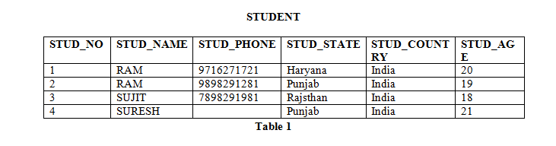
How to find functional dependencies for a relation?
Functional Dependencies in a relation are dependent on the domain of the relation.
Consider the STUDENT relation given in Table 1.
We know that STUD_NO is unique for each student.
So STUD_NO->STUD_NAME, STUD_NO->STUD_PHONE, STUD_NO->STUD_STATE, STUD_NO->STUD_COUNTRY and STUD_NO -> STUD_AGE all will be true.
Similarly, STUD_STATE->STUD_COUNTRY will be true as if two records have same STUD_STATE, they will have same STUD_COUNTRY as well.

Slide 26
Examples of FD constraints
An FD is a property of the attributes in the schema R
The constraint must hold on every relation instance r(R)
If K is a key of R, then K functionally determines all attributes in R
(since we never have two distinct tuples with t1[K]=t2[K])

Slide 27
Attribute Closure
Attribute Closure: Attribute closure of an attribute set can be defined as set of attributes which can be functionally determined from it.
To find attribute closure of an attribute set:
Add elements of attribute set to the result set.
Recursively add elements to the result set which can be functionally determined
from the elements of the result set.
Using FD set of table 1, attribute closure can be determined as:
(STUD_NO)+ = {STUD_NO, STUD_NAME, STUD_PHONE, STUD_STATE, STUD_COUNTRY, STUD_AGE}
(STUD_STATE)+ = {STUD_STATE, STUD_COUNTRY}

Slide 28
Example Problem
Consider the relation scheme R = {E, F, G, H, I, J, K, L, M, M} and the set of functional dependencies {{E, F} -> {G}, {F} -> {I, J}, {E, H} -> {K, L}, K -> {M}, L -> {N} on R. What is the key for R? (GATE-CS-2014) A. {E, F} B. {E, F, H} C. {E, F, H, K, L} D. {E}
Answer: Finding attribute closure of all given options, we get: {E,F}+ = {EFGIJ} {E,F,H}+ = {EFHGIJKLMN} {E,F,H,K,L}+ = {{EFHGIJKLMN} {E}+ = {E} {EFH}+ and {EFHKL}+ results in set of all attributes, but EFH is minimal. So it will be candidate key. So correct option is (B).

Slide 29
For the following Student table instance, find all the possible functional dependencies that are held.
[ Schema - Student (Regno, Name, DOB, Phone, Gender, Course_ID, Course_Name, Instructor_ID, Instructor_Name, Instructor_Office)]
Regno | Name | DOB | Phone | Gender | CID | CName | Ins_ID | Ins_Name | Ins_Office
14M01 | Kumar | 12-Jan-1996 | 12345 | M | C1 | DBMS | I1 | Kesav | G123
14M05 | Mary | 10-Jun-1995 | 12367 | F | C1 | DBMS | I1 | Kesav | G123
14M07 | Ram | 10-May-1996 | 12898 | M | C1 | DBMS | I2 | Ragav | G127
14M01 | Kumar | 12-Jan-1996 | 12345 | M | C3 | DS | I5 | Mani | G125
14B01 | Revathi | 10-Dec-1995 | 23456 | F | C3 | DS | I5 | Mani | G125
14M09 | Steve | 23-Oct-1995 | 34567 | M | C4 | OS | I5 | Mani | G125
14B03 | Ramya | 20-Jul-1996 | 23456 | F | C4 | OS | I5 | Mani | G125
Regno → Name
– Names are uniquely identified by a regno. In other words, for a given register number, there is exactly one name.
Regno → DOB - For any given register number in Student, there is exactly one DOB value.
Regno → Phone
Regno → Gender
You can write the above FDs collectively as follows;
Regno → Name, DOB, Phone, Gender

Slide 30
2.2 Inference Rules for FDs (1)
Given a set of FDs F, we can infer additional FDs that hold whenever the FDs in F hold
Armstrong's inference rules:
IR1. (Reflexive) If Y subset-of X, then X -> Y
IR2. (Augmentation) If X -> Y, then XZ -> YZ
(Notation: XZ stands for X U Z)
IR3. (Transitive) If X -> Y and Y -> Z, then X -> Z
IR1, IR2, IR3 form a sound and complete set of inference rules
These are rules hold and all other rules that hold can be deduced from these

Slide 31
Inference Rules for FDs (2)
Some additional inference rules that are useful:
Decomposition: If X -> YZ, then X -> Y and X -> Z
Union: If X -> Y and X -> Z, then X -> YZ
Psuedotransitivity: If X -> Y and WY -> Z, then WX -> Z
The last three inference rules, as well as any other inference rules, can be deduced from IR1, IR2, and IR3 (completeness property)

Slide 32
2.4 Minimal Sets of FDs (1)
A set of FDs is minimal if it satisfies the following conditions:
Every dependency in F has a single attribute for its RHS.
We cannot remove any dependency from F and have a set of dependencies that is equivalent to F.
We cannot replace any dependency X -> A in F with a dependency Y -> A, where Y proper-subset-of X ( Y subset-of X) and still have a set of dependencies that is equivalent to F.

Slide 33
Thank you

